Slide 1

How to add the official website of an institution
Notes:
Hello and welcome!
In this tutorial you will learn how to add the official website of an institution in Wikidata.
Use the arrows on the slides to navigate through the tutorial.

Slide 2
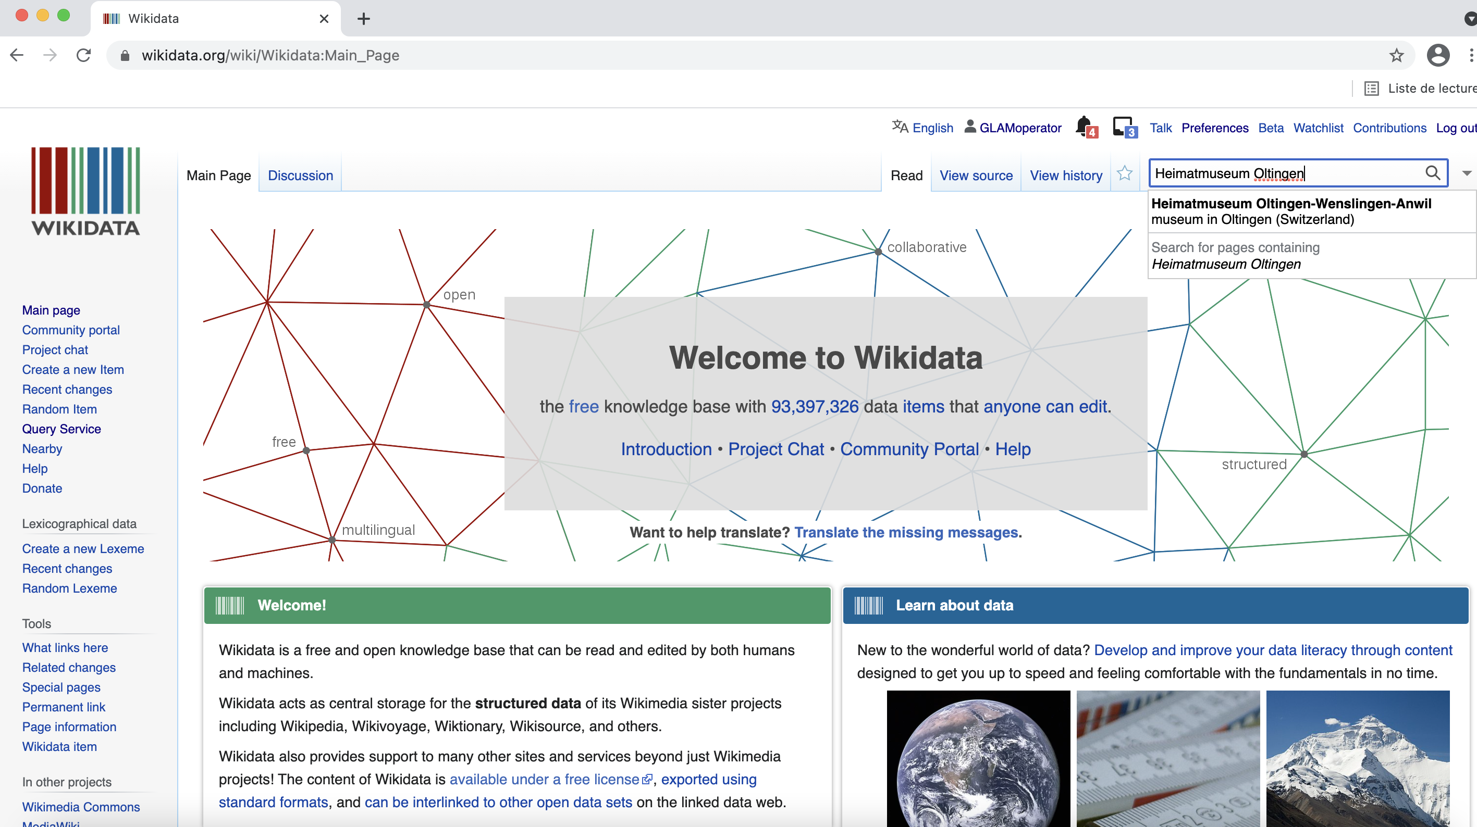
Notes:
As an example, we have chosen the Heimatsmuseum Oltingen-Wenslingen-Anwil, a local museum in the Canton Basel Land. On the Wikidata homepage, enter the name of the institution in the search field on the top right. Then select the corresponding Wikidata item.

Slide 3
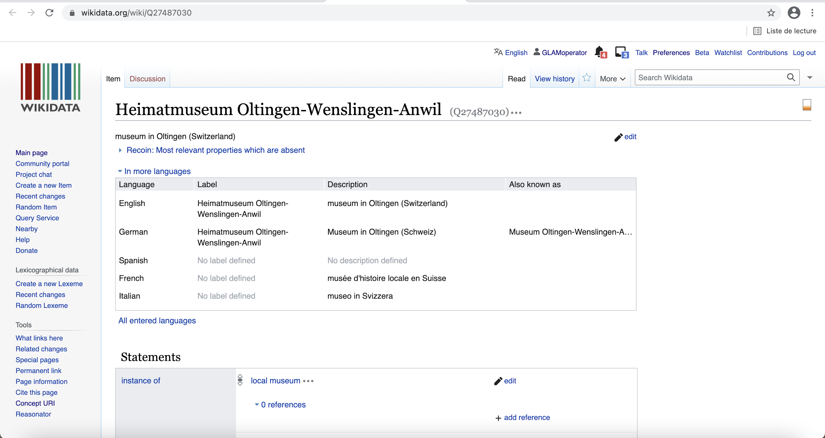
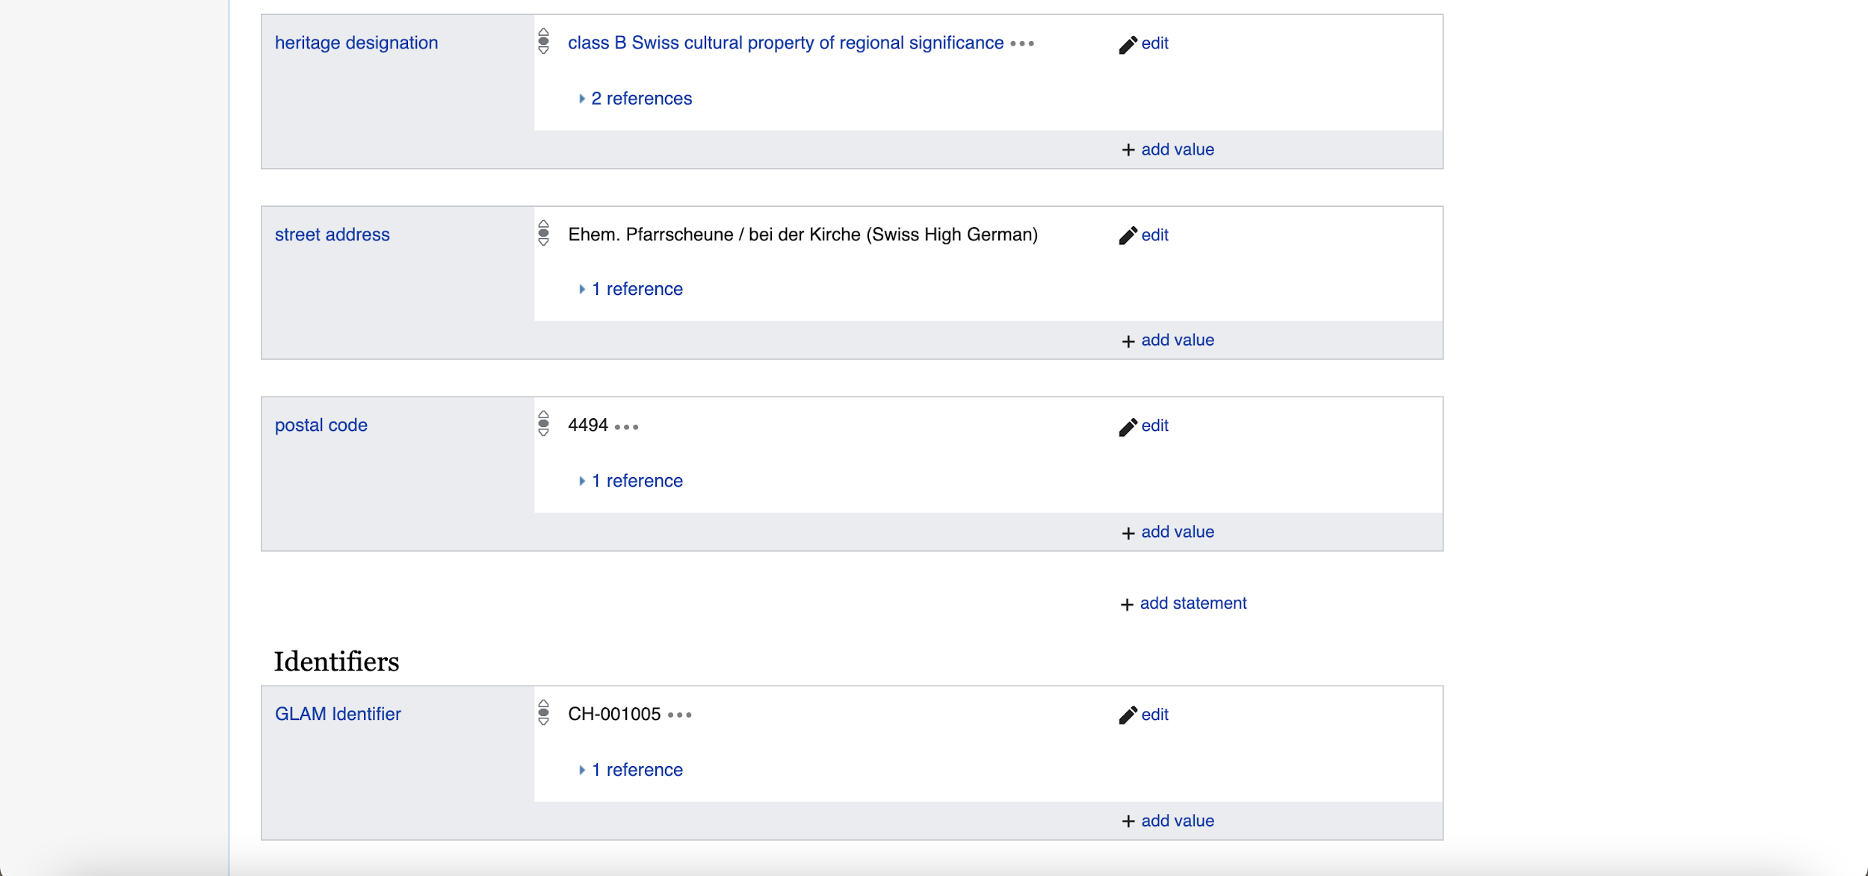
Notes:
You are now on the Wikidata item page of the Heimatsmuseum Oltingen-Wenslingen-Anwil. Scroll down the list of statements and click on: add statement.

Slide 4
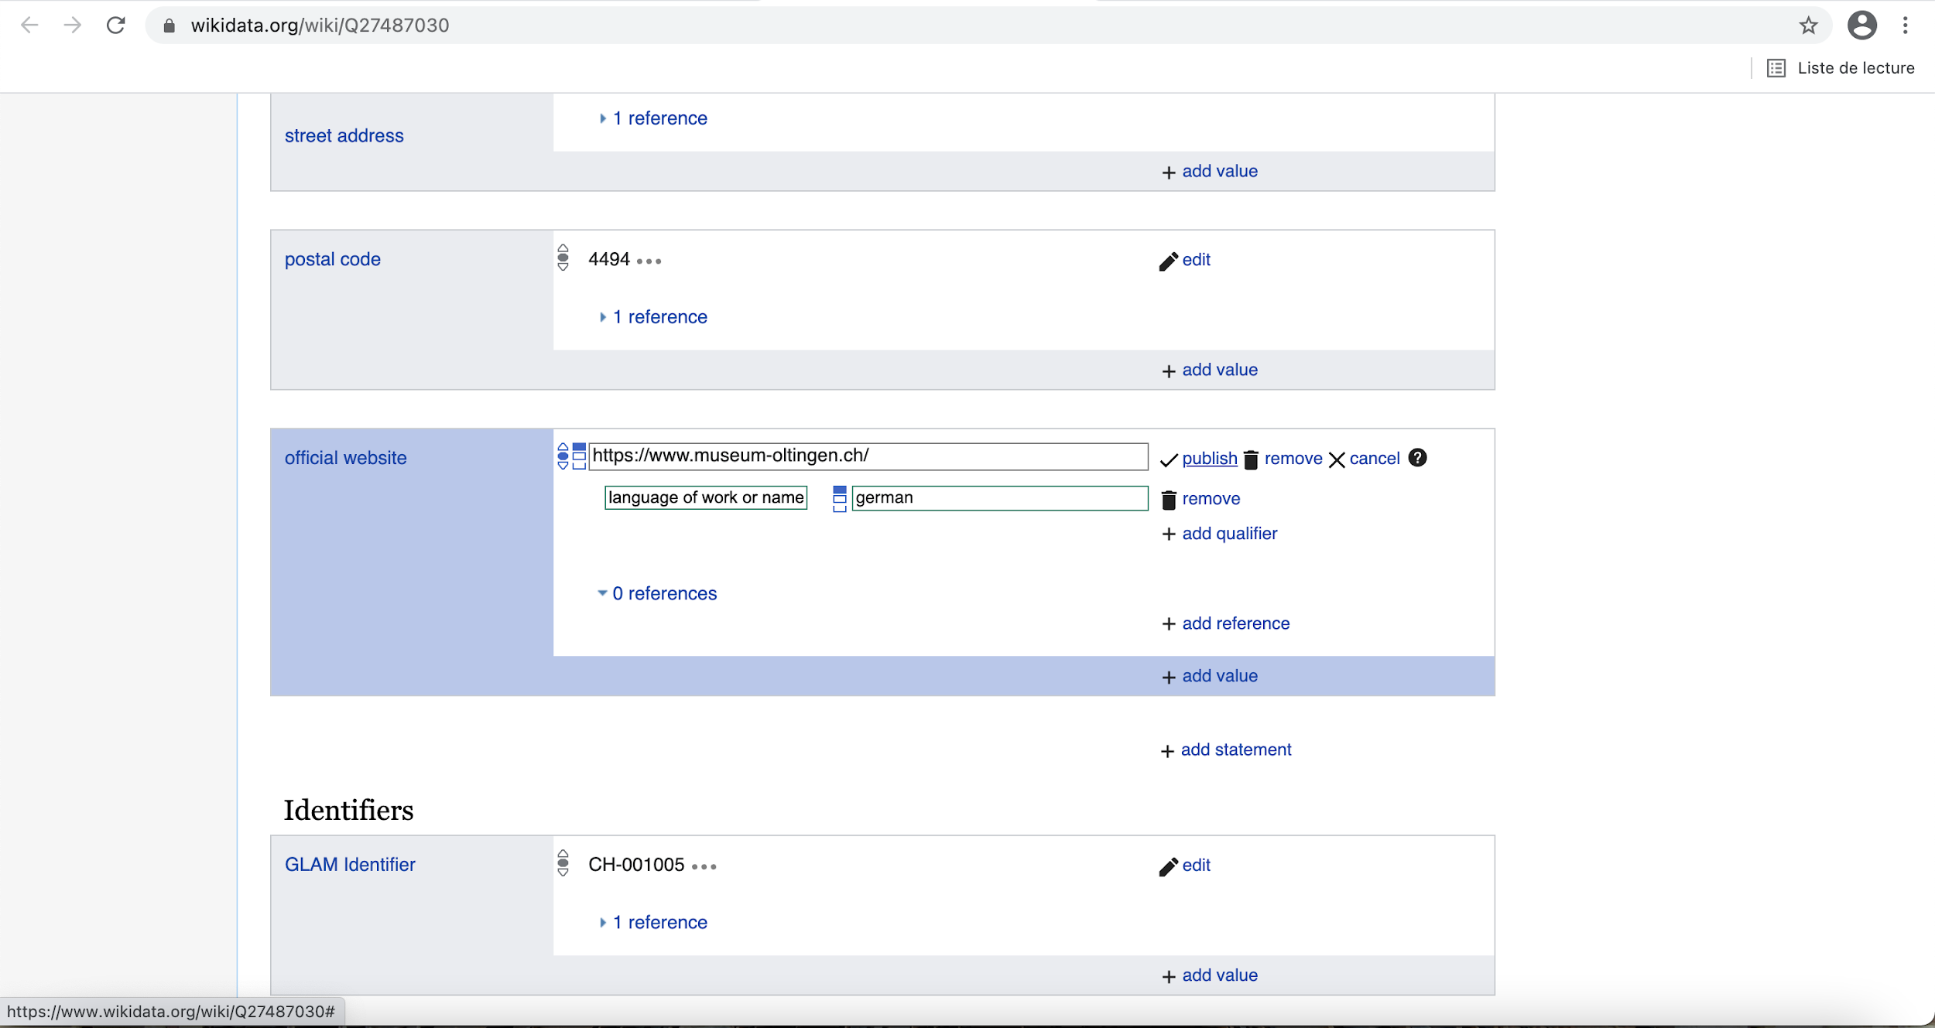
Notes:
In the property field on the left, select: official website.
Copy and paste the URL of the official website of the institution in the middle field.
As Wikidata is a multilingual platform used by people from all around the world, it is useful to specify the language of the website.
To do this, click on: add qualifier. Select: language of work or name.
Add the language of the official website.
Then click on: publish. Now you are done!

Slide 5
Congratulations!
Visit our website to download further tutorials:
https://tutorials.schoolofdata.ch/
Notes:
Congratulations! You now know how to add the official website of an institution.

