Slide 1
How to create a Wikidata user account
Notes:
Hello and welcome!
In this tutorial, you will learn how to create your Wikidata user account.
Click on the arrows to navigate through the slides and listen to the audio instructions on each slide.

Slide 2
LINK
Notes:
First, go to the Wikidata homepage by clicking on the hyperlink.
Select « create an acocunt » on the upper right side.

Slide 3
Notes:
Enter the required information.
First select a user name and password.
Confirm your password.
Fill out the captcha and save the information by clicking on « create your account ».

Slide 4
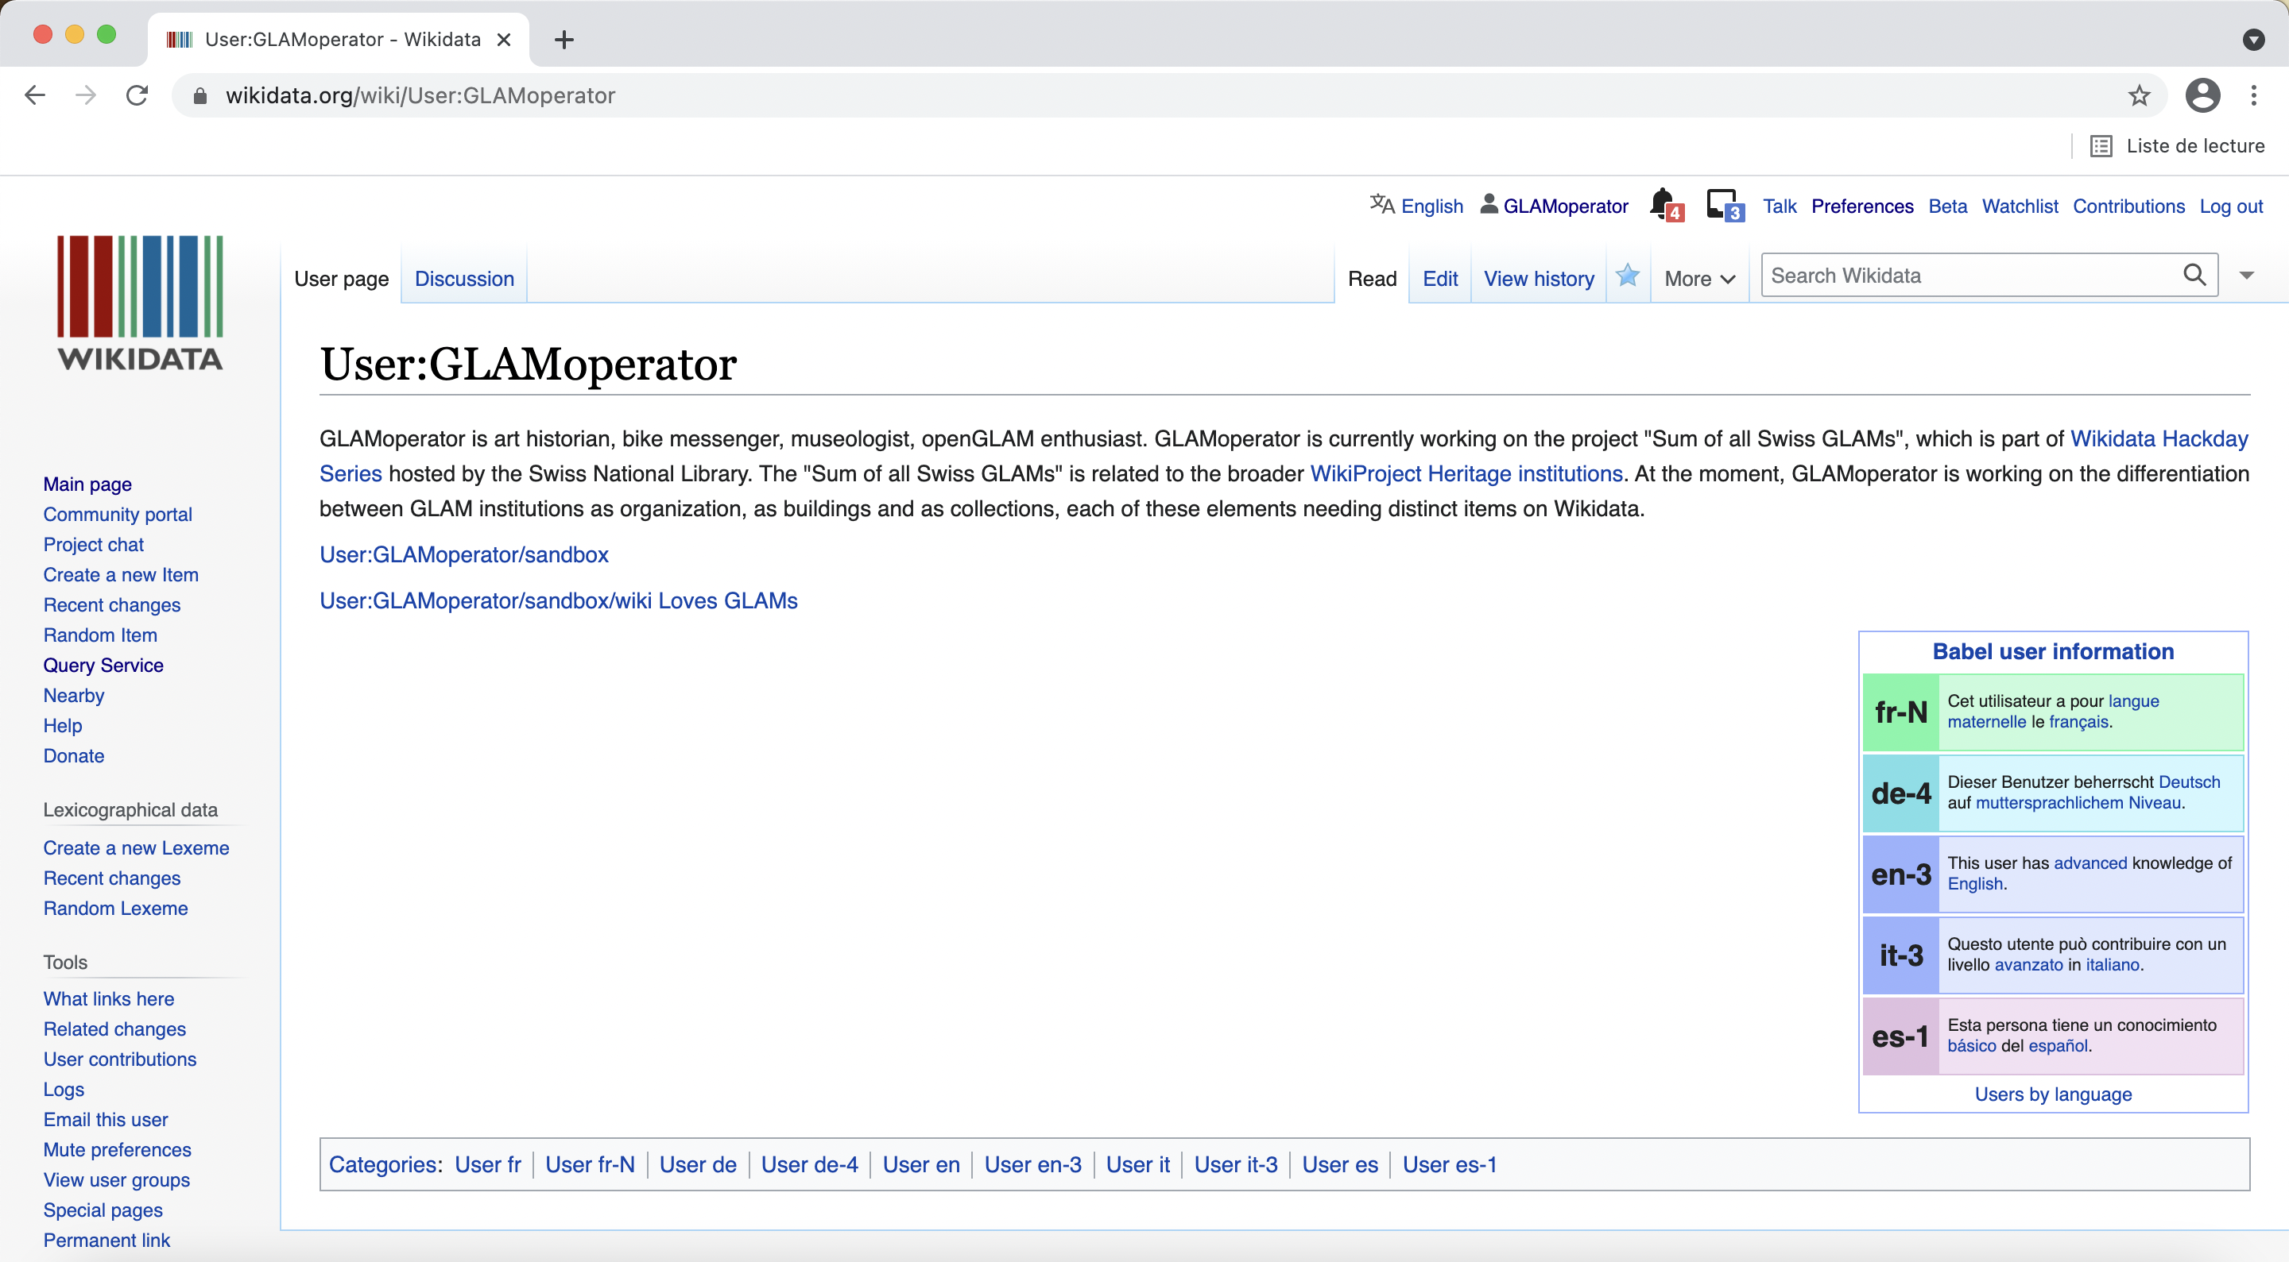
Notes:
When you are logged in, click on your user name.
This takes you to your personal user page. All user pages are public.
They can be seen by all other users, but only you can edit your page.
Click on the edit button and write something about yourself and why you are using Wikidata.
You can also add a babel table to show which languages you know.
Other users can contact you via your user page.

Slide 5
Congratulations!
Link to tutorial:
How to add the official website of an institution
Notes:
Congratulations! You are now ready to contribute to Wikidata!
Why not start by making a simple edit?
Follow this link to learn how to add the official website of an institution in Wikidata.

