Slide 1
Add the official street address of an institution
Notes:
Hello and welcome! In this tutorial you will learn how to enter the official address of an institution on Wikidata.

Slide 2
We would like to thank Wikimedia Switzerland for their support in the production of this tutorial.
Notes:
Wir bedanken uns bei Wikimedia Schweiz für die Unterstützung bei der Herstellung dieses Tutorials.

Slide 3
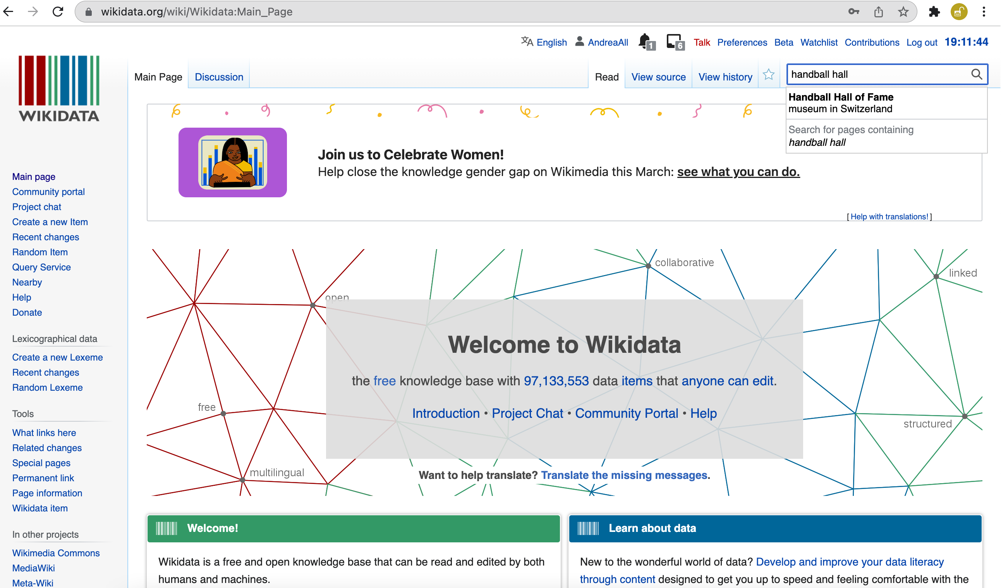
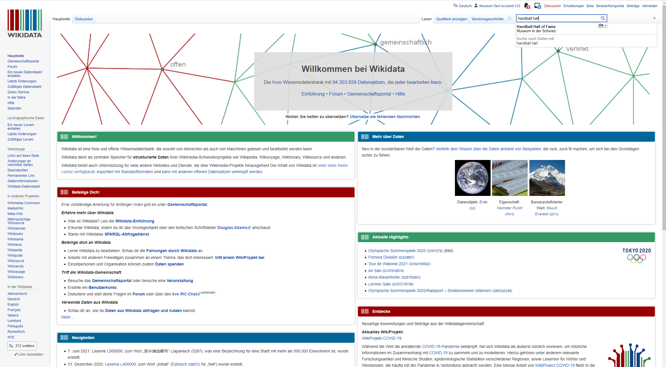
Notes:
Before you start this tutorial, please make sure that you are logged in to Wikidata. Now search for the desired institution. In our example, we have chosen the Swiss Handball Hall of Fame.

Slide 4
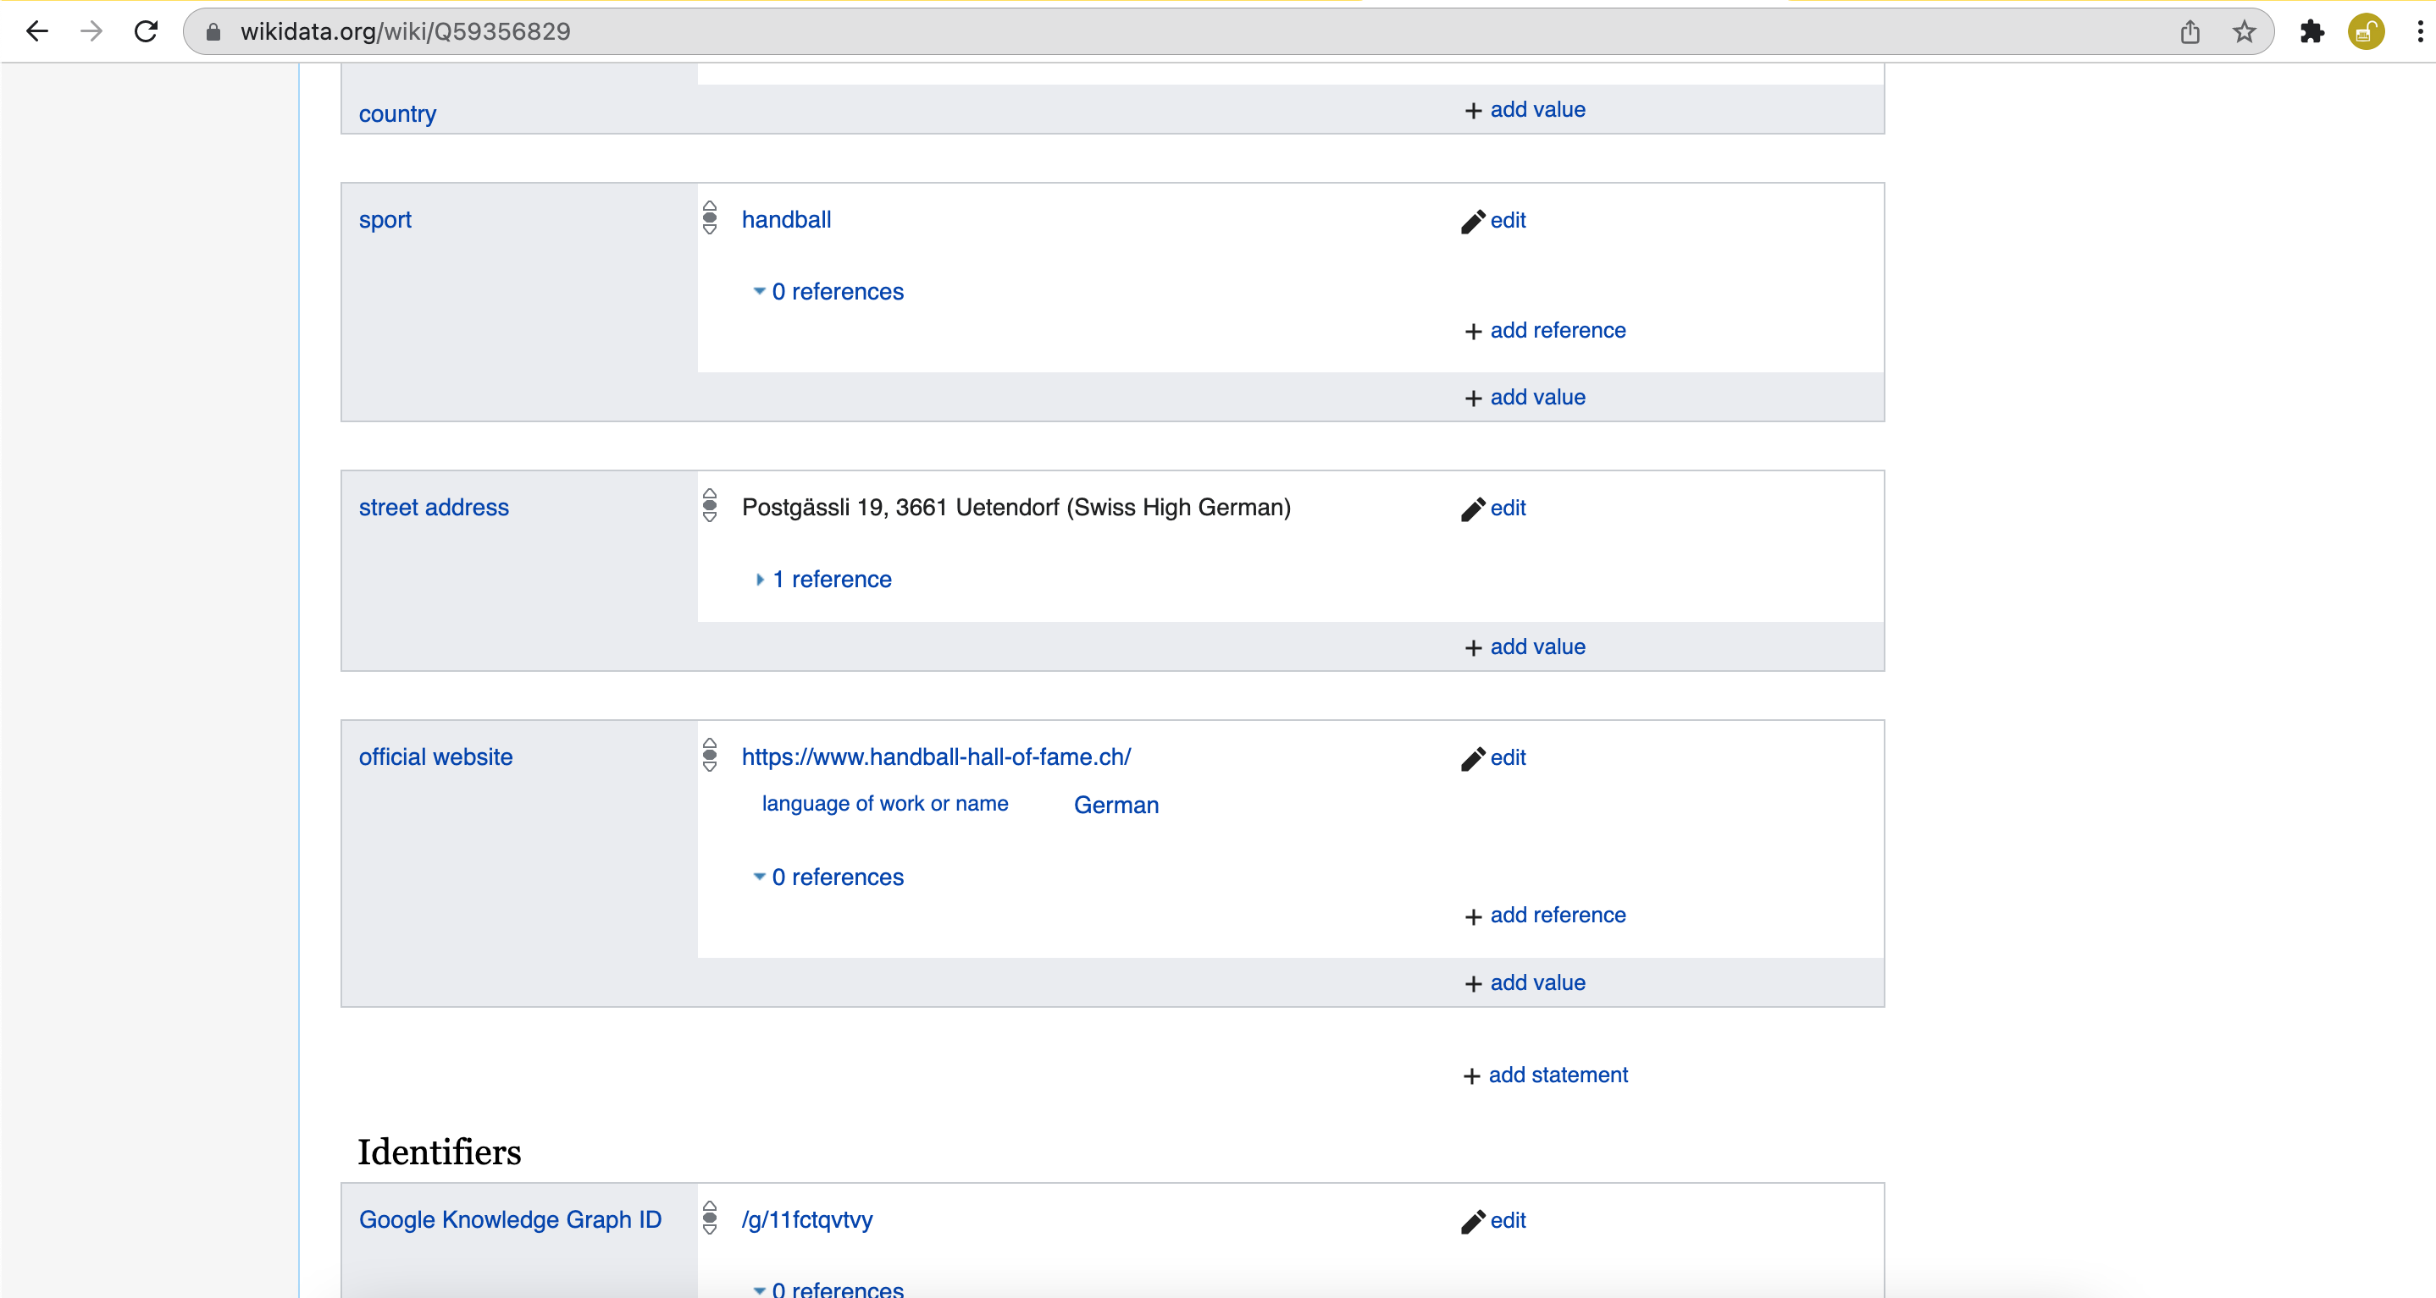
Notes:
Once on the Wikidata page of the desired institution, scroll to the end of the list of statements and select Add statement.

Slide 5
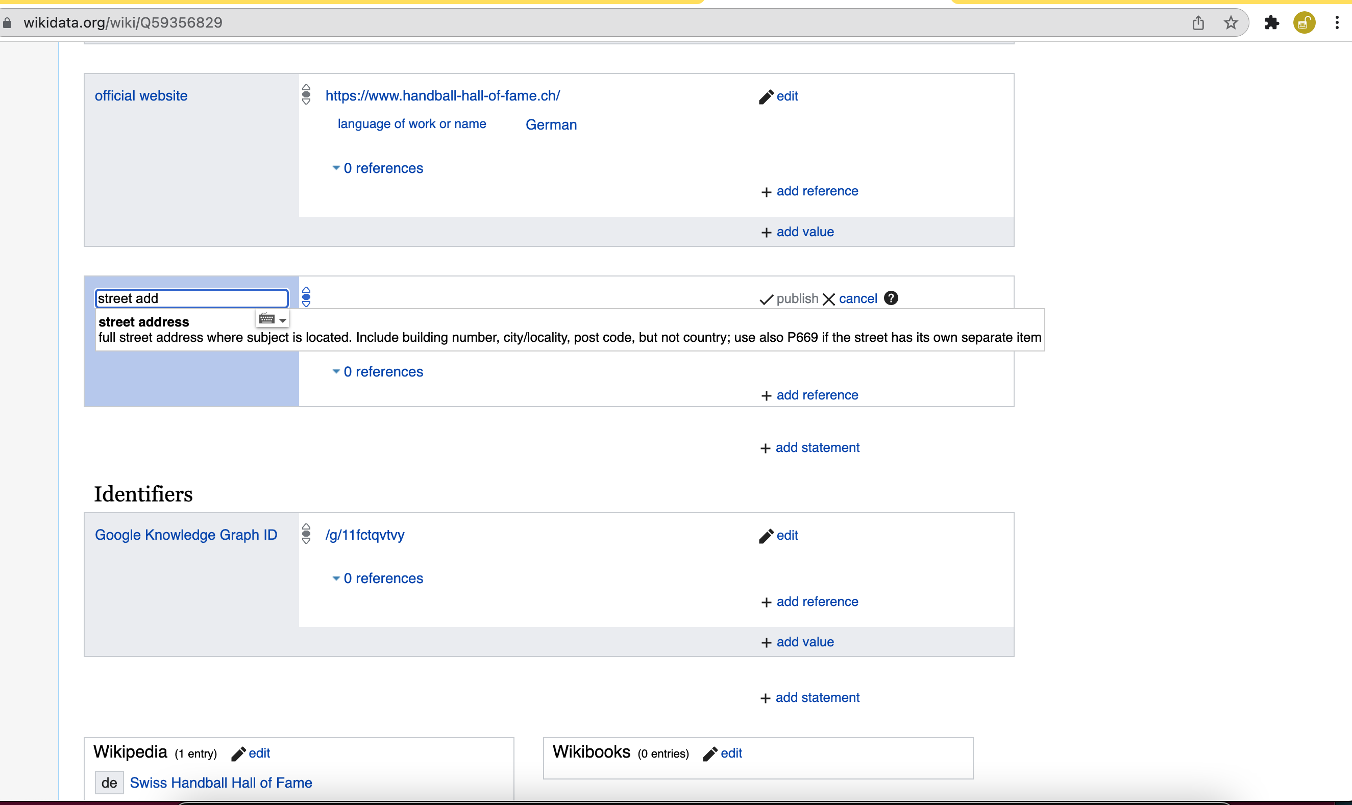
Notes:
In the search field that asks for the property, now search for the property ”Street Address" and select it.

Slide 6
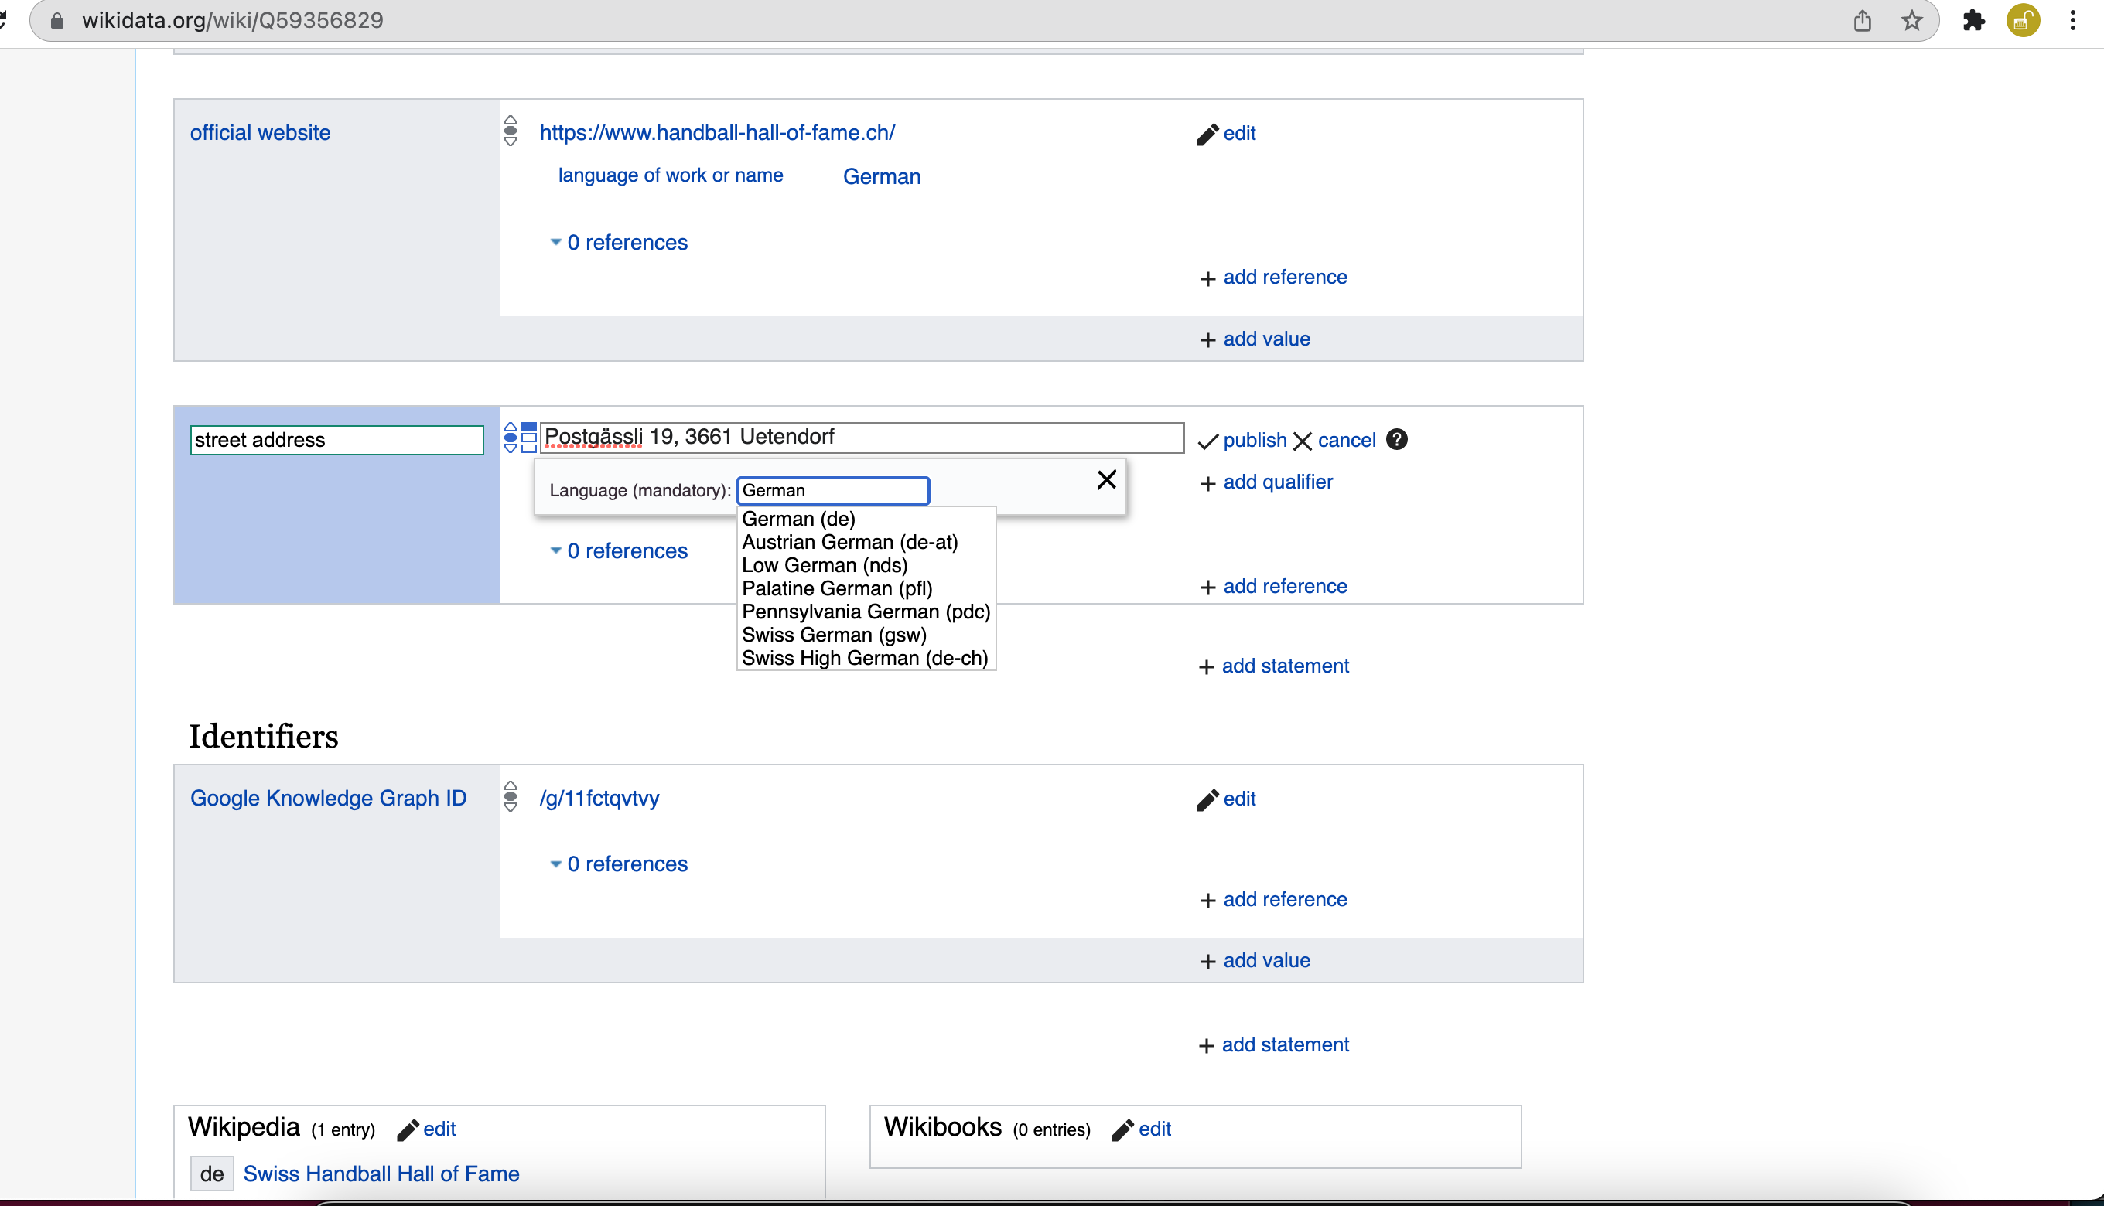
Notes:
Copy the address of the institution into the field provided. Then enter the language of the stored address. Without specifying the language, you cannot publish the statement afterwards.

Slide 7
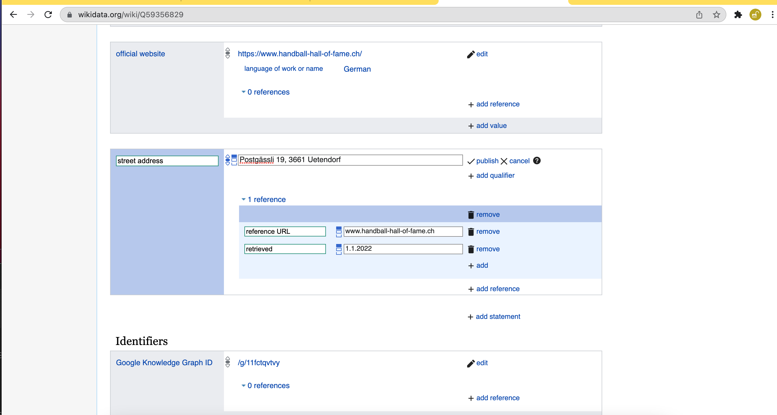
Notes:
Now you can enter the reference. For this purpose, enter the URL and the date on which you found the information about the address. Once you have entered all the information, you can click on the, Publish, button.

Slide 8
Congratulations!
Visit our website or our YouTube-Channel to find more tutorials about WikiData.
Website: https://tutorials.schoolofdata.ch/
YouTube: https://bit.ly/GLAMtutorial
Notes:
Congratulations. You now know how to add the official address of an institution on Wikidata. Visit our website or our YouTube channel to watch more tutorials.

