Slide 1
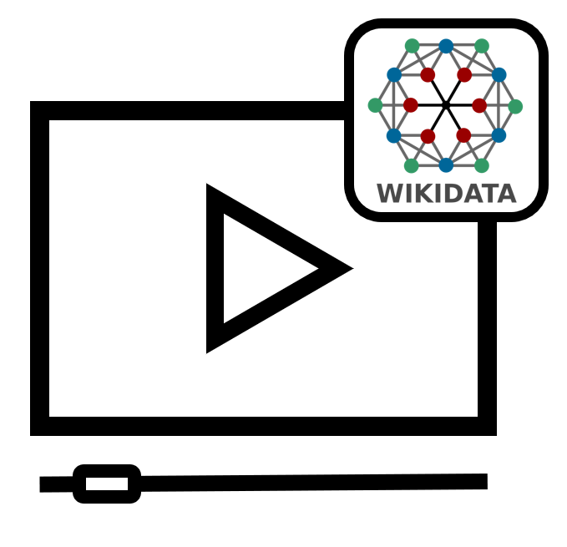
Upload images to Wikimedia Commons
Notes:
Hello and welcome! In this tutorial you will learn how to add an image to Wikimedia Commons.

Slide 2
We would like to thank Wikimedia Switzerland for their support in the production of this tutorial.
Notes:
We would like to thank Wikimedia Switzerland for their support in the production of this tutorial.

Slide 3
https://commons.wikimedia.org/
Notes:
Image, video and audio files are not uploaded directly to Wikidata, but to Wikimedia Commons. Wikimedia Commons is a media collection for public domain and freely licensed media content and is also a Wikimedia project. Currently, there are over 80 million files on Wikimedia Commons. So, if you want to upload an image file for a data object on Wikidata, you do not do this directly on Wikidata, but you upload the image file to Wikimedia Commons and can then reference it within a Wikidata statement.

Slide 4
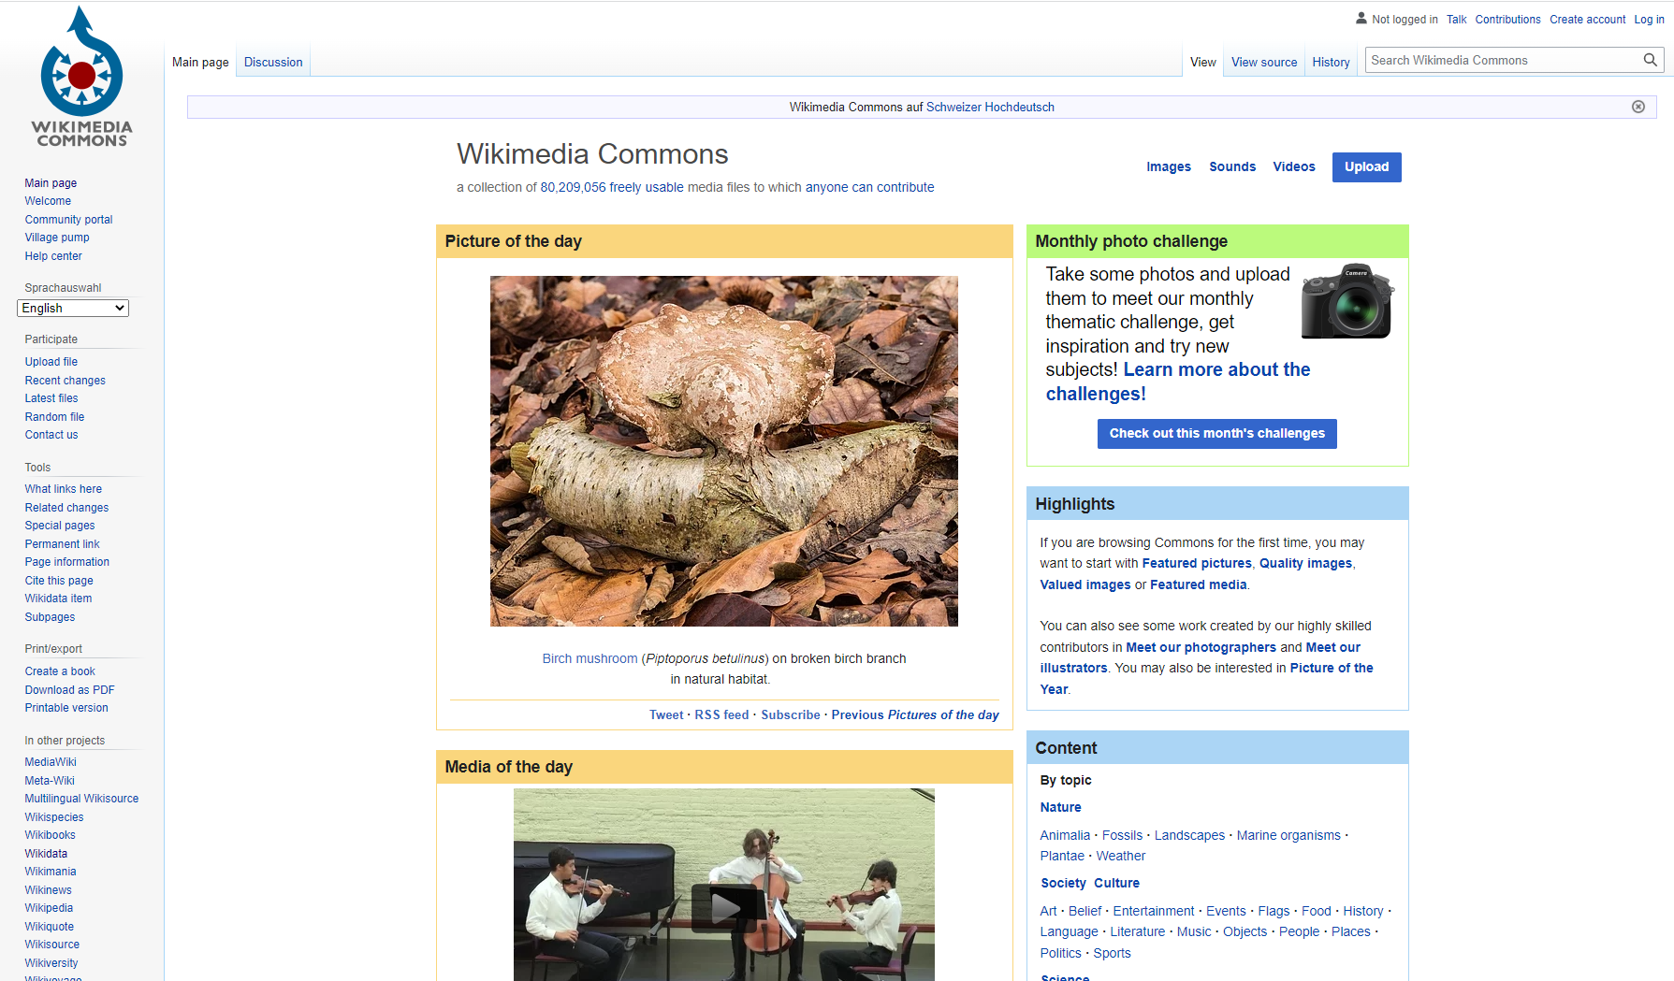
Notes:
After clicking on the link, you will be redirected to the Wikimedia Commons homepage. Make sure you are logged in.

Slide 5
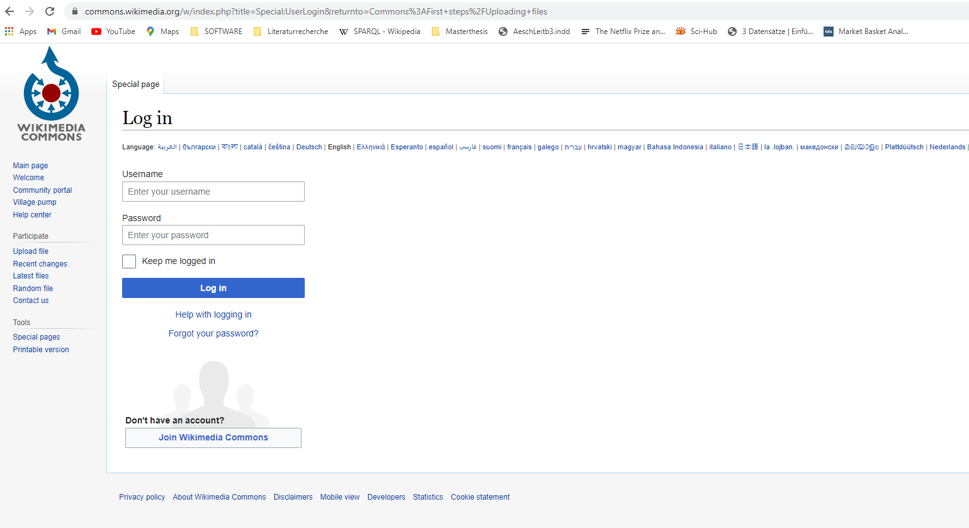
Notes:
To log in to Wikimedia Commons, you can use the same login data as for Wikidata or Wikipedia. You do not need to create an additional account. By the way, this applies to all Wikimedia projects. You only need to create one account in total.

Slide 6
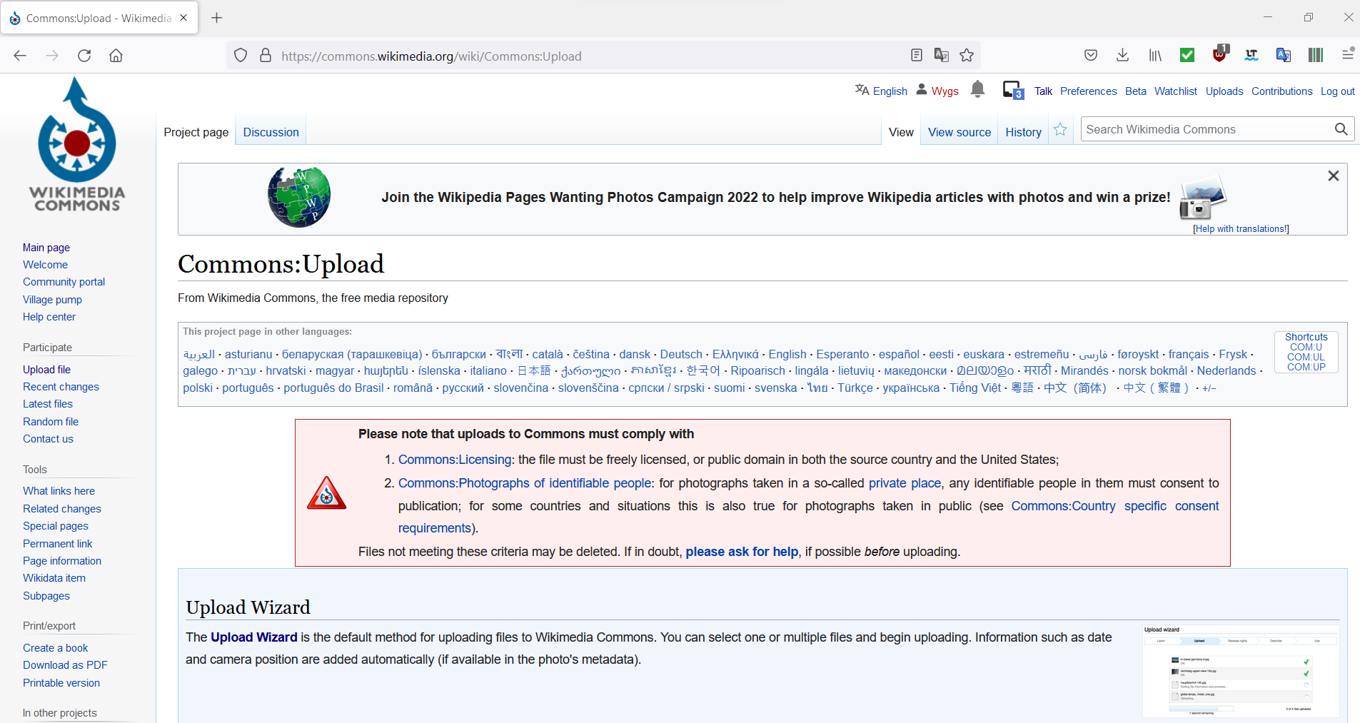
Notes:
After you have logged in, please click on "Upload file" in the left menu. On the upload page, click on "Upload Wizard" to start the image upload process.

Slide 7
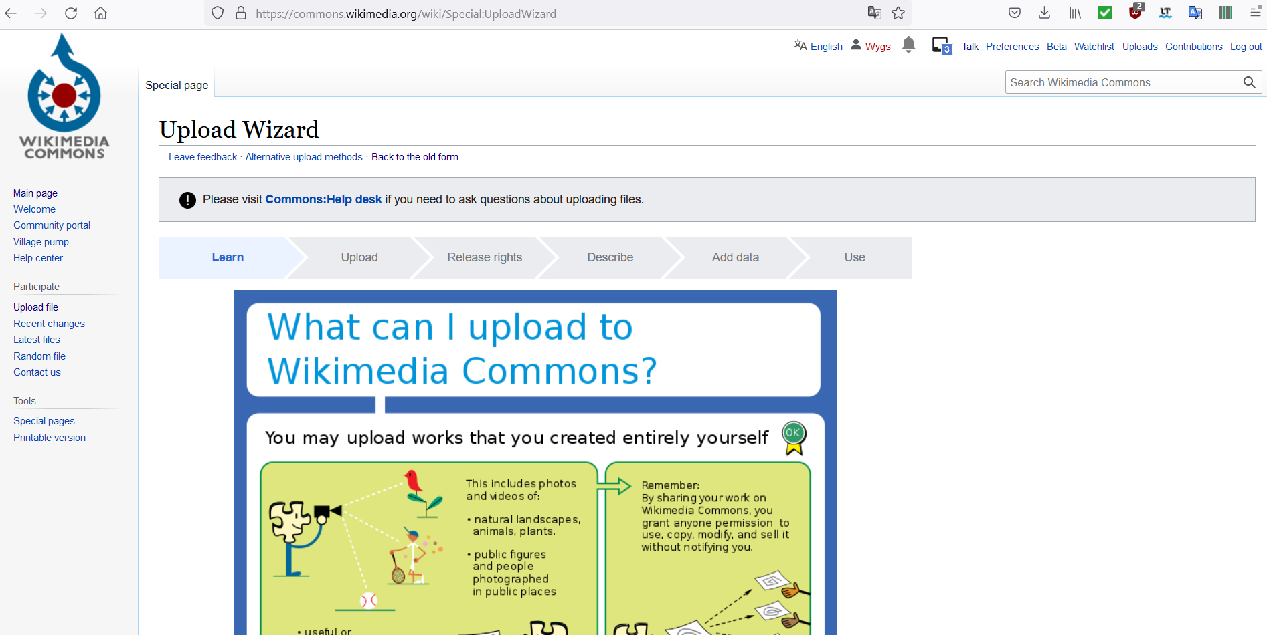
Notes:
With the help of the "Upload Wizard" - the assistant for uploading files to Wikimedia Commons - you will be guided step by step through the upload process.

Slide 8
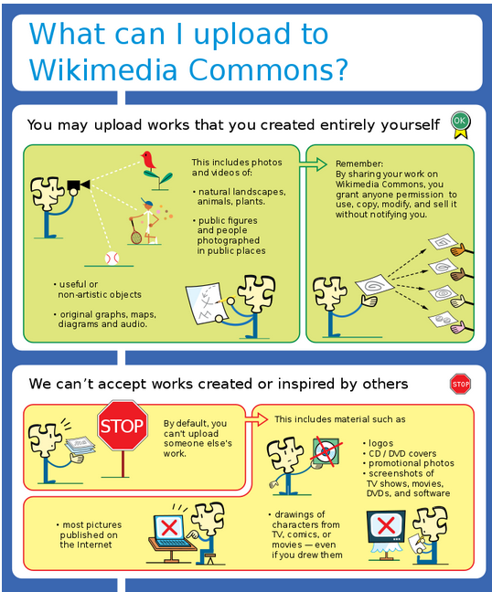
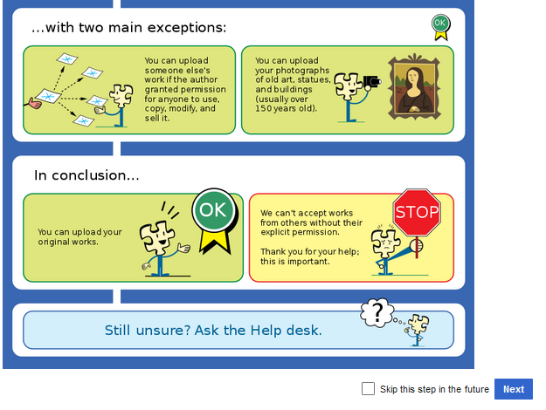
Notes:
In the first step of the process, you will be informed which files you are allowed to upload to Wikimedia Commons and what the legal consequences of an upload are. Please read this information carefully before you start uploading. After you have read through the information, click on the "Next" button.

Slide 9
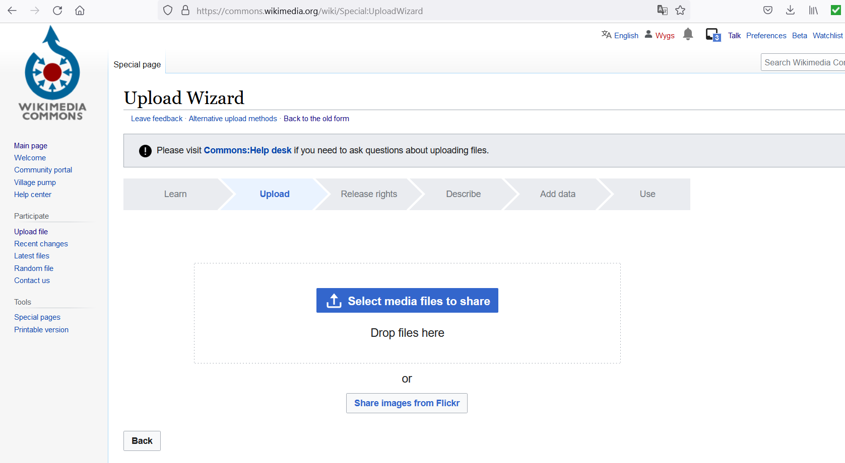
Notes:
If you now have a file that you are allowed to upload according to the rules mentioned earlier, click on the button marked in blue and then select the corresponding file.

Slide 10
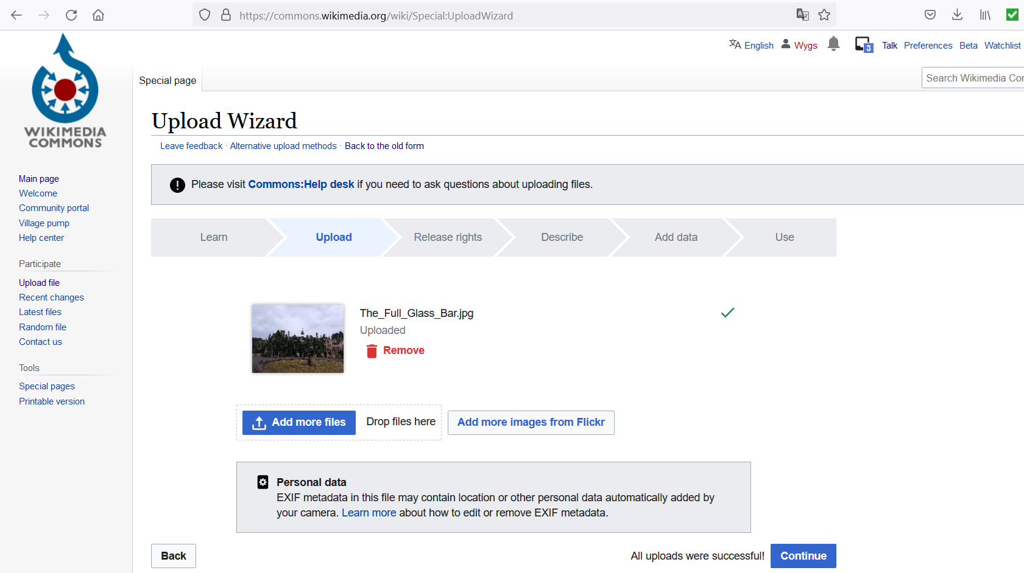
Notes:
Check that you have uploaded the correct image file and click on "Continue".

Slide 11
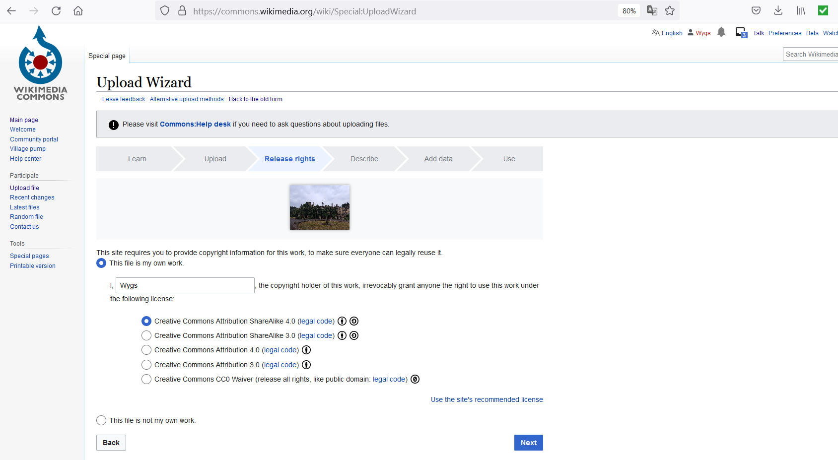
Notes:
Now select the appropriate license for your image file and click on "Next".

Slide 12
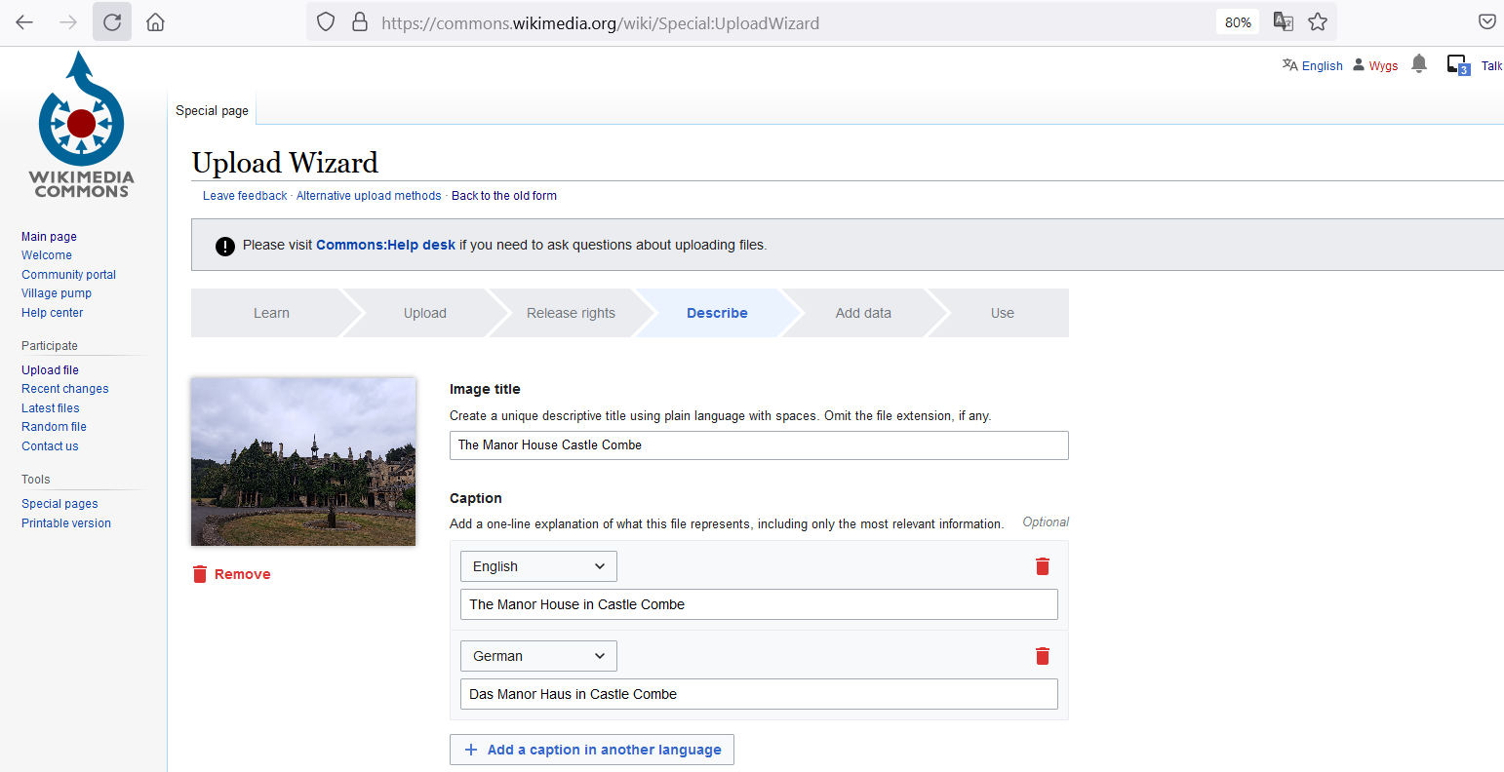
Notes:
In this step you can select a suitable image title, as well as set the media caption in different languages.

Slide 13
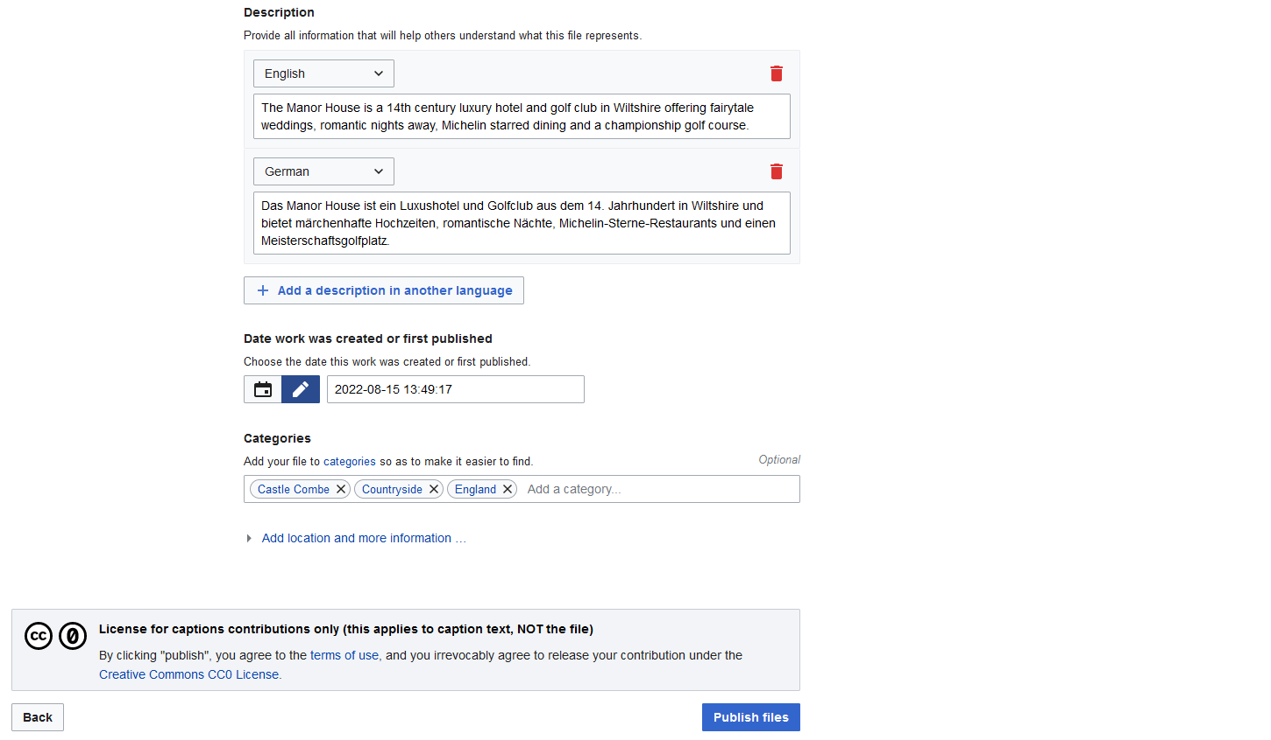
Notes:
Below the captions, you can also add a description of the image in as many languages as you wish, as well as the date on which the work was first created or published. Finally, if you wish, you can add three categories to make the image file easier to find. Now publish the file by clicking on "Publish files".

Slide 14
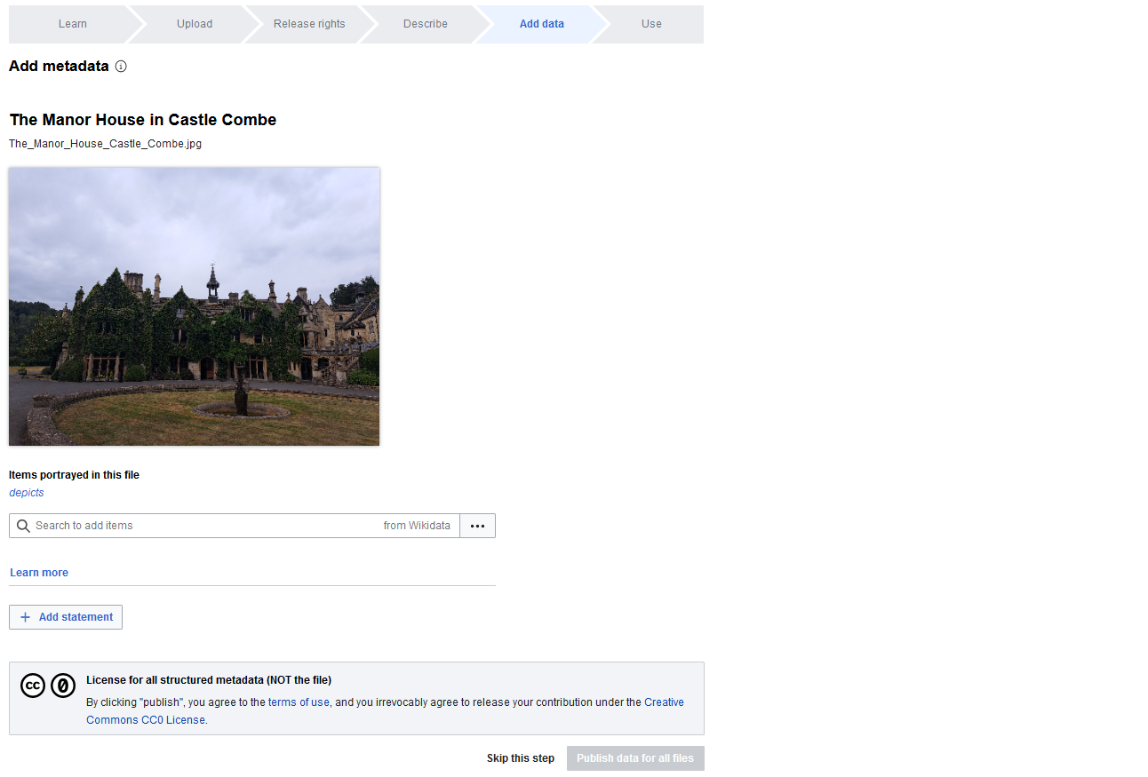
Notes:
If necessary, you can now add metadata so that the file can be found quickly in the future. Once you have added the metadata, you can publish it by clicking on the blue buttons. However, this step is optional and can also be skipped.

Slide 15
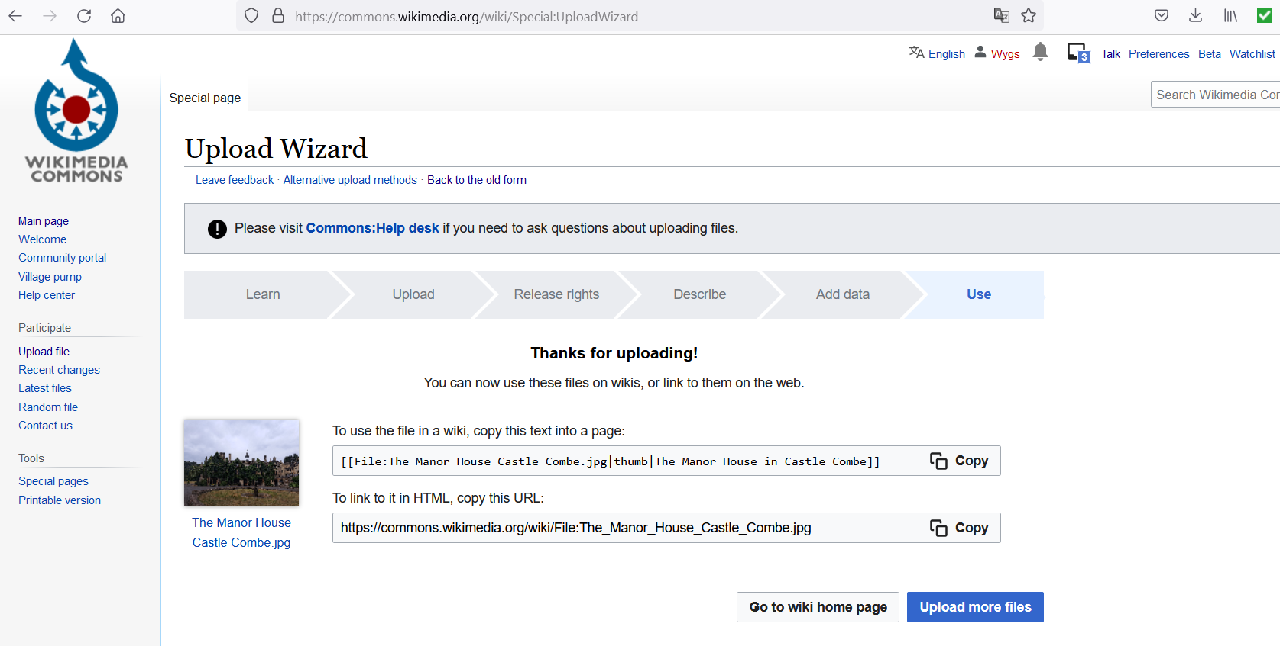
Notes:
In the last step, you will now be provided with the code line for embedding in wiki pages. Alternatively, you will also find an HTML link that you can use for embedding.

Slide 16
Congratulations!
Visit our website or YouTube channel to watch more tutorials.
Website: https://tutorials.schoolofdata.ch/
YouTube: https://bit.ly/GLAMtutorial
Notes:
Congratulations. You now know how to upload image files to Wikimedia Commons. Visit our website or YouTube channel to watch more tutorials.

