Slide 1
Add coordinates of an institution
Notes:
Hello and welcome! In this tutorial you will learn how to add the coordinates of an institution on Wikidata.

Slide 2
We would like to thank Wikimedia Switzerland for their support in the production of this tutorial.
Notes:
We would like to thank Wikimedia Switzerland for their support in the production of this tutorial.

Slide 3
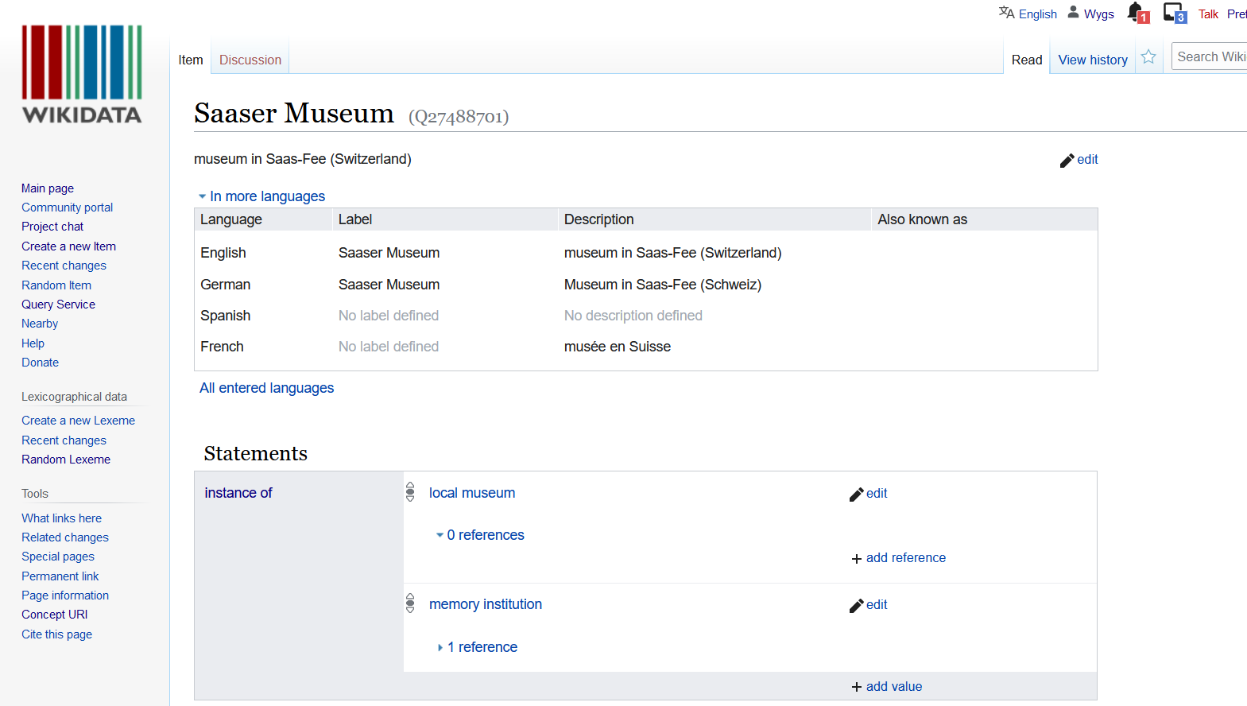
Notes:
Go to the Wikidata page of the institution you are looking for. In this example we will add the coordinates of the Saaser Museum.

Slide 4
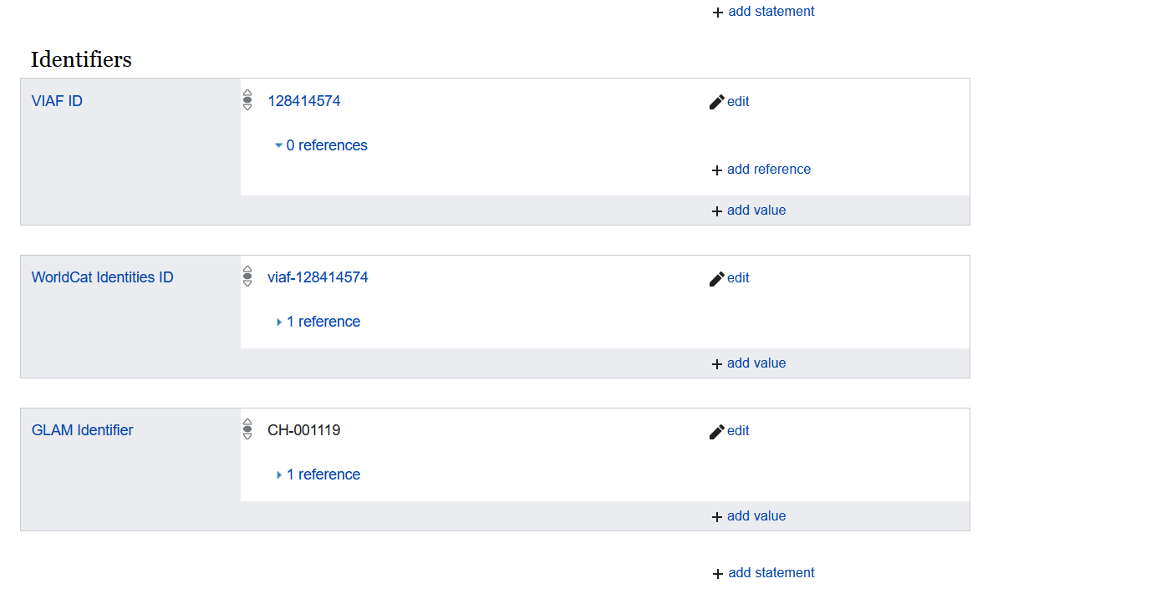
Notes:
Scroll down and click on “add value".

Slide 5
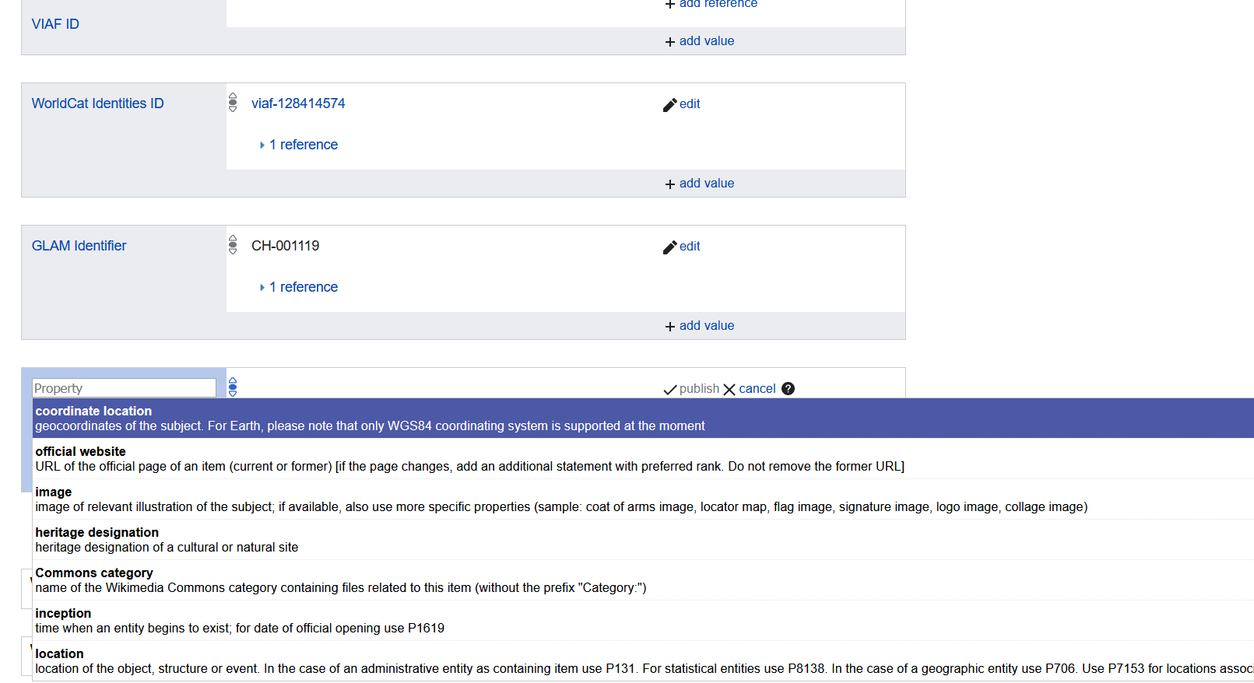
Notes:
Search for the property “coordinate location" and select it.

Slide 6
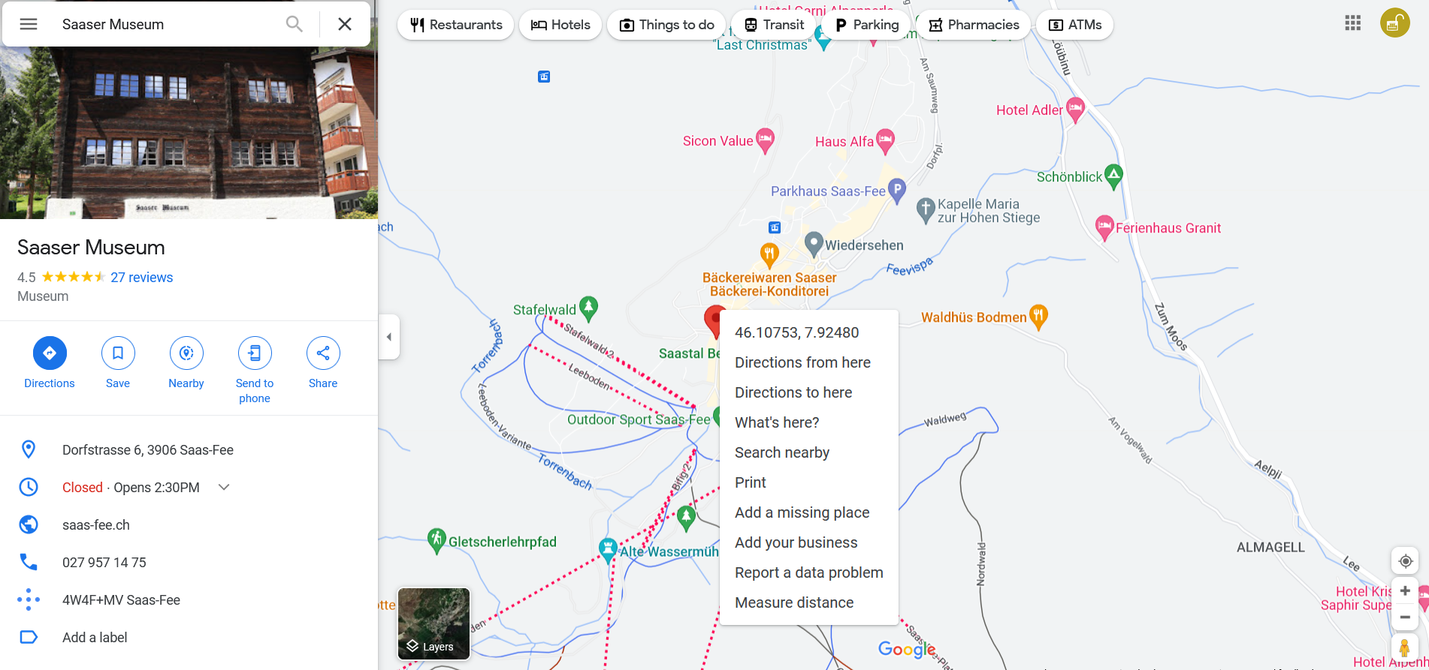
Notes:
Now search on Google Maps for the desired institution or the address where the institution is located. By right-clicking on the red pin, you can find the coordinates of the institution. Click on the coordinates with the left mouse button so that they are copied to the clipboard.

Slide 7
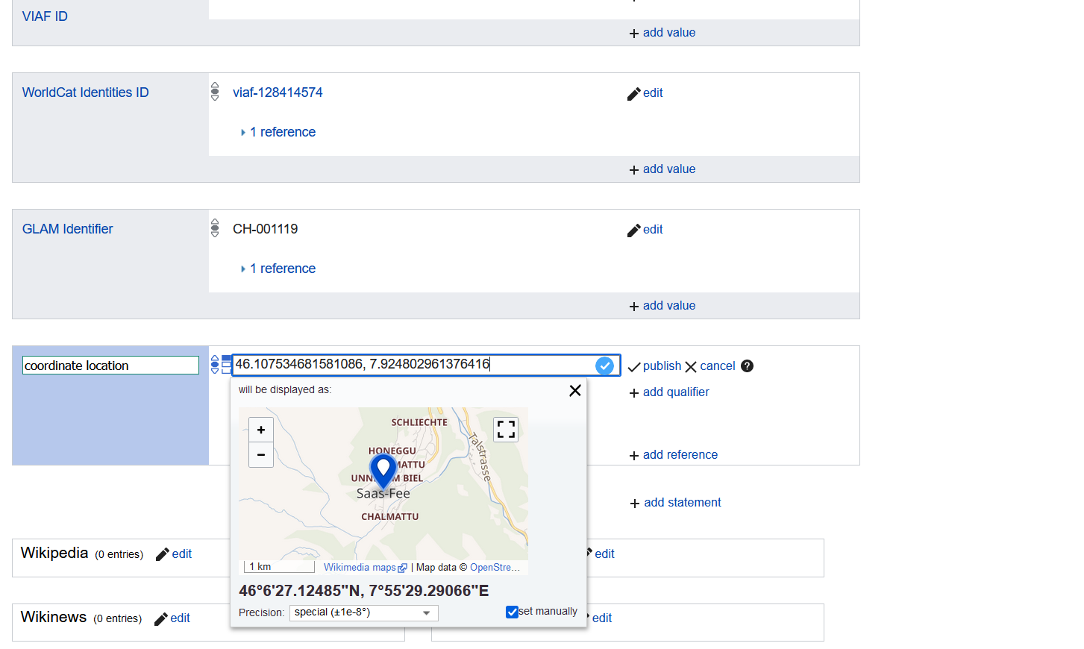
Notes:
Now insert the coordinates into the corresponding field. Check again whether the marked location on the map corresponds to the real location. Now you can publish the statement.

Slide 8
Congratulations!
Visit our website or YouTube channel to watch more tutorials.
Website: https://tutorials.schoolofdata.ch/
YouTube: https://bit.ly/GLAMtutorial
Notes:
Congratulations. You now know how to add the coordinates of an institution on Wikidata. Visit our website or our YouTube channel to watch more tutorials.

